Slide 1
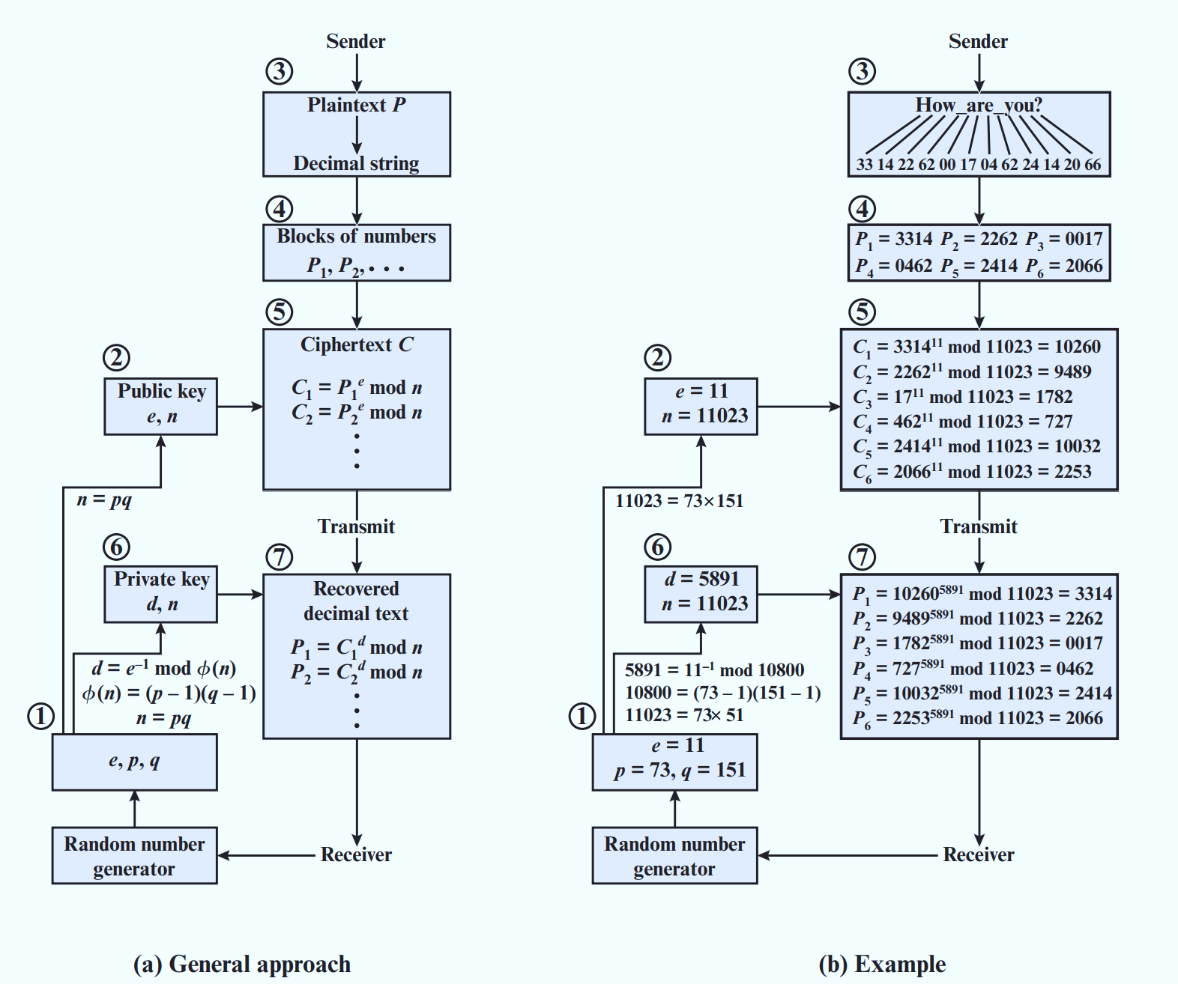
CH 09 - RSA Processing of Multiple Blocks

Slide 2
The Security of RSA
Brute force: This involves trying all possible private keys.
Mathematical attacks: There are several approaches, all equivalent in effort to factoring the product of two primes.
Timing attacks: These depend on the running time of the decryption algorithm.
Hardware fault-based attack: This involves inducing hardware faults in the processor that is generating digital signatures.
Chosen ciphertext attacks: This type of attack exploits the properties of the RSA algorithm.

Slide 3
TIMING ATTACKS
A timing attack is somewhat analogous to a burglar guessing the combination of a safe by observing how long it takes for someone to turn the dial from number to number.
Timing attacks are applicable not just to RSA, but to other public-key cryptography systems.
This attack is alarming for two reasons: It comes from a completely unexpected direction, and it is a ciphertext only attack

Slide 4
Countermeasures of timing attack
Constant exponentiation time: Ensure that all exponentiations take the same amount of time before returning a result. This is a simple fix but does degrade performance.
Random delay: Better performance could be achieved by adding a random delay to the exponentiation algorithm to confuse the timing attack. Kocher points out that if defenders don’t add enough noise, attackers could still succeed by collecting additional measurements to compensate for the random delays.
Blinding: Multiply the ciphertext by a random number before performing exponentiation. This process prevents the attacker from knowing what ciphertext bits are being processed inside the computer and therefore prevents the bit-by-bit analysis essential to the timing attack.

Slide 5
FAULT-BASED ATTACK
Still another unorthodox approach to attacking RSA is reported in [PELL10].
The approach is an attack on a processor that is generating RSA digital signatures.
The attack induces faults in the signature computation by reducing the power to the processor. The faults cause the software to produce invalid signatures, which can then be analyzed by the attacker to recover the private key.
The authors show how such an analysis can be done and then demonstrate it by extracting a 1024-bit private RSA key in approximately 100 hours, using a commercially available microprocessor

Slide 6
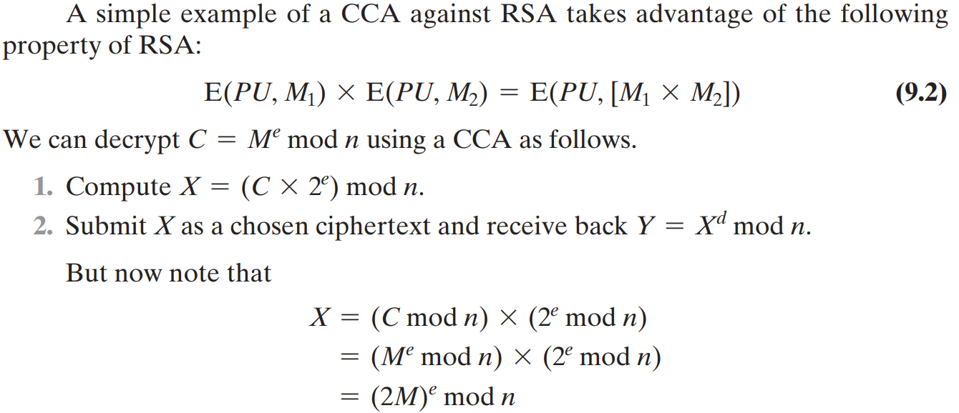
CHOSEN CIPHERTEXT ATTACK AND OPTIMAL ASYMMETRIC ENCRYPTION PADDING
Therefore, Y = (2M) mod n. From this, we can deduce M.
To overcome this simple attack, practical RSA-based cryptosystems randomly pad the plaintext prior to encryption. Optimal Asymmetric Encryption Padding (OAEP)

Slide 7
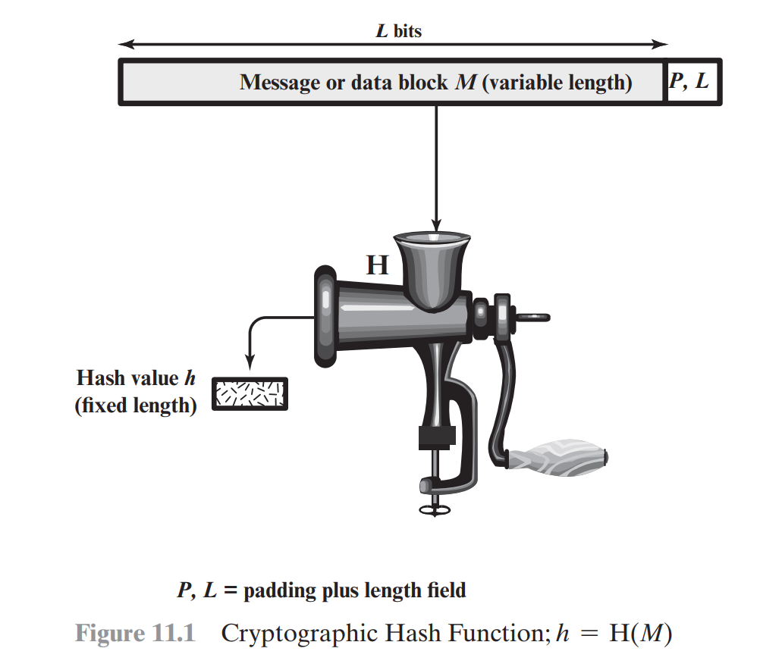
CH 11 - Cryptographic Hash Functions
A hash function H accepts a variable-length block of data M as input and produces a fixed-size hash value h = H(M).
In general terms, the principal object of a hash function is data integrity.
The kind of hash function needed for security applications is referred to as a cryptographic hash function.

Slide 8
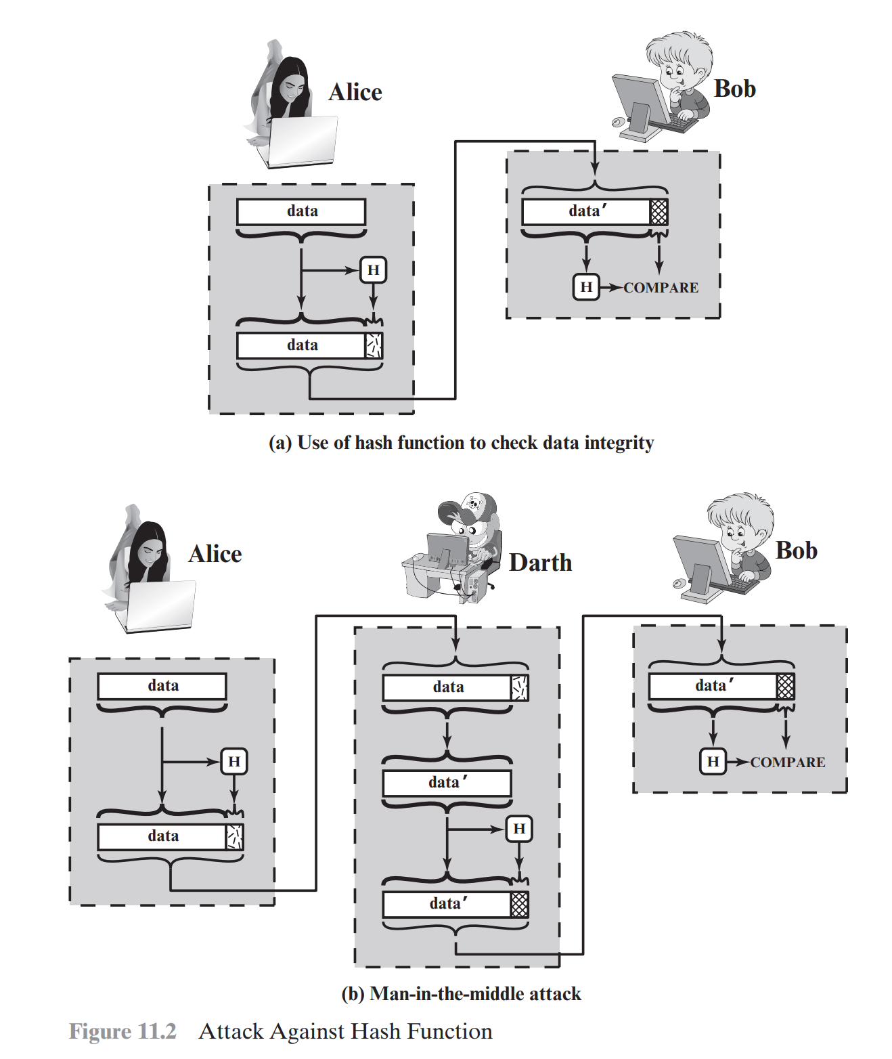
APPLICATIONS OF CRYPTOGRAPHIC HASH FUNCTIONS

Slide 9
Message Authentication
Message authentication is a mechanism or service used to verify the integrity of a message.
Message authentication assures that data received are exactly as sent (i.e., there is no modification, insertion, deletion, or replay).

Slide 10
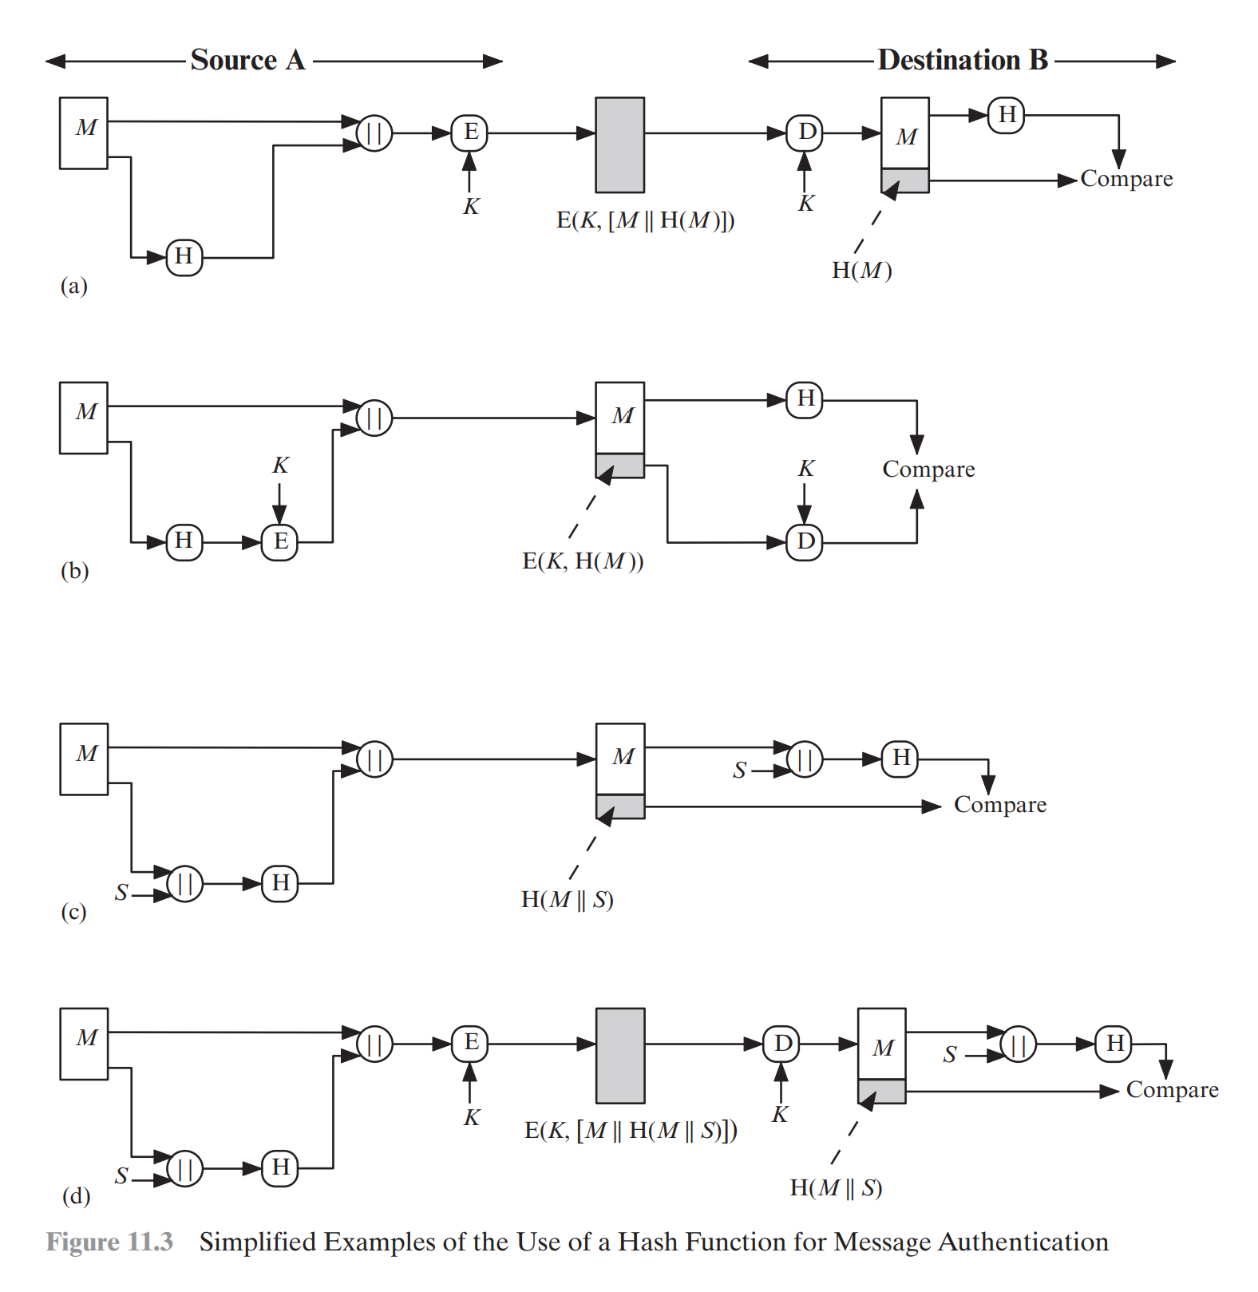
variety of ways in which a hash code can be used to provide message authentication

Slide 11
variety of ways in which a hash code can be used to provide message authentication
The message plus concatenated hash code is encrypted using symmetric encryption. Because only A and B share the secret key, the message must have come from A and has not been altered. The hash code provides the structure or redundancy required to achieve authentication. Because encryption is applied to the entire message plus hash code, confidentiality is also provided.
Only the hash code is encrypted, using symmetric encryption. This reduces the processing burden for those applications that do not require confidentiality.
It is possible to use a hash function but no encryption for message authentication. The technique assumes that the two communicating parties share a common secret value S. A computes the hash value over the concatenation of M and S and appends the resulting hash value to M. Because B possesses S, it can recompute the hash value to verify. Because the secret value itself is not sent, an opponent cannot modify an intercepted message and cannot generate a false message.
Confidentiality can be added to the approach of method (c) by encrypting the entire message plus the hash code.

Slide 12
When confidentiality is not required, method (b) has an advantage over methods (a) and (d), which encrypts the entire message, in that less computation is required.
Encryption software is relatively slow. Even though the amount of data to be encrypted per message is small, there may be a steady stream of messages into and out of a system.
Encryption hardware costs are not negligible. Low-cost chip implementations of DES are available, but the cost adds up if all nodes in a network must have this capability.
Encryption hardware is optimized toward large data sizes. For small blocks of data, a high proportion of the time is spent in initialization/invocation overhead.
Encryption algorithms may be covered by patents, and there is a cost associated with licensing their use.

Slide 13
message authentication code (MAC)
Message authentication is achieved using a message authentication code (MAC), also known as a keyed hash function.
Typically, MACs are used between two parties that share a secret key to authenticate information exchanged between those parties.
A MAC function takes as input a secret key and a data block and produces a hash value, referred to as the MAC, which is associated with the protected message.

Slide 14
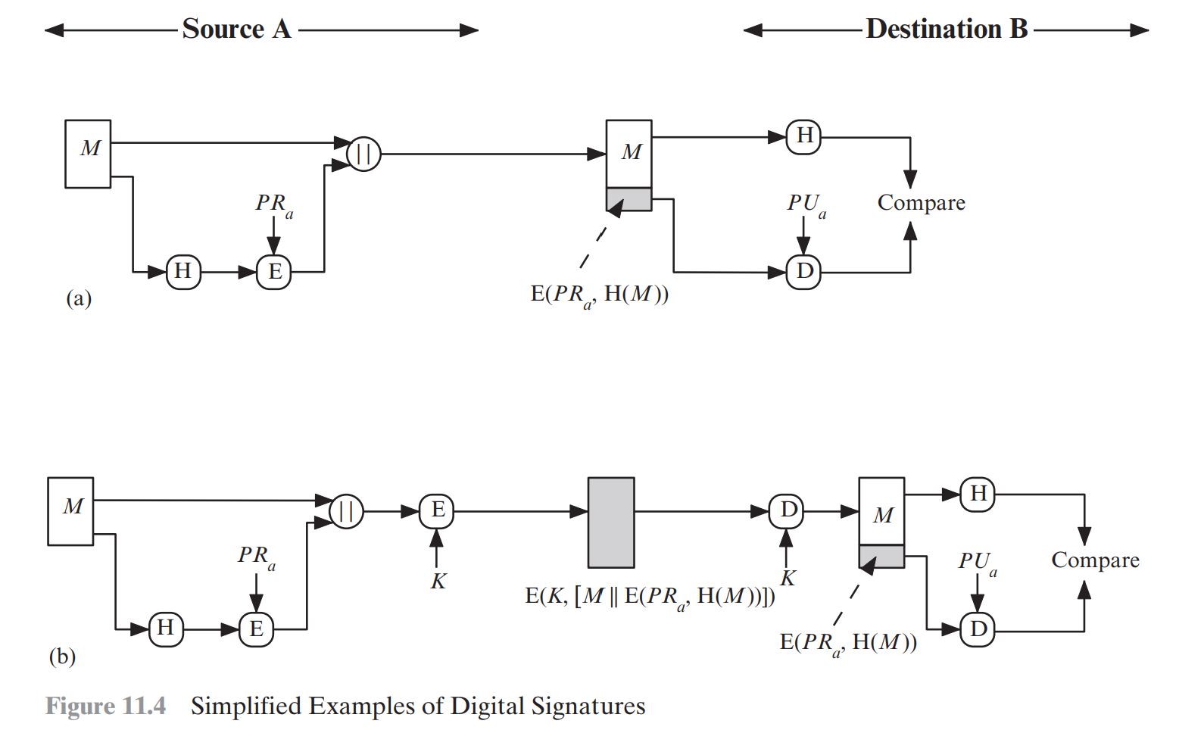
Digital Signatures

Slide 15
Digital Signatures
The hash code is encrypted, using public-key encryption with the sender’s private key. As with Figure 11.3b, this provides authentication. It also provides a digital signature, because only the sender could have produced the encrypted hash code. In fact, this is the essence of the digital signature technique.
If confidentiality, as well as a digital signature, is desired, then the message plus the private-key-encrypted hash code can be encrypted using a symmetric secret key. This is a common technique.

Slide 16
Other Applications of Hash function
Hash functions are commonly used to create a one-way password file. A hash of a password is stored by an operating system rather than the password itself for most OS.
When a user enters a password, the hash of that password is compared to the stored hash value for verification. This approach to password protection is used by most operating systems.
Hash functions can be used for intrusion detection and virus detection. Store H(F) for each file on a system and secure the hash values later to determine if a file has been modified by recomputing H(F).
A cryptographic hash function can be used to construct a pseudorandom function (PRF) or a pseudorandom number generator (PRNG).

Slide 17
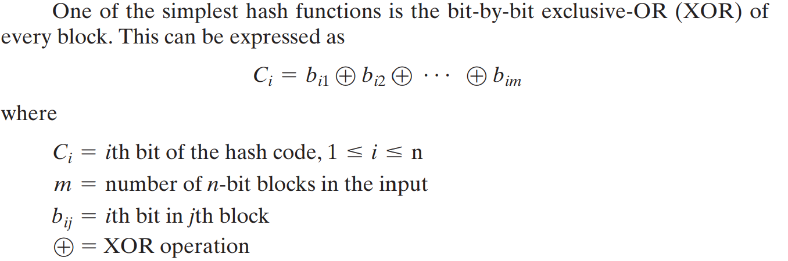
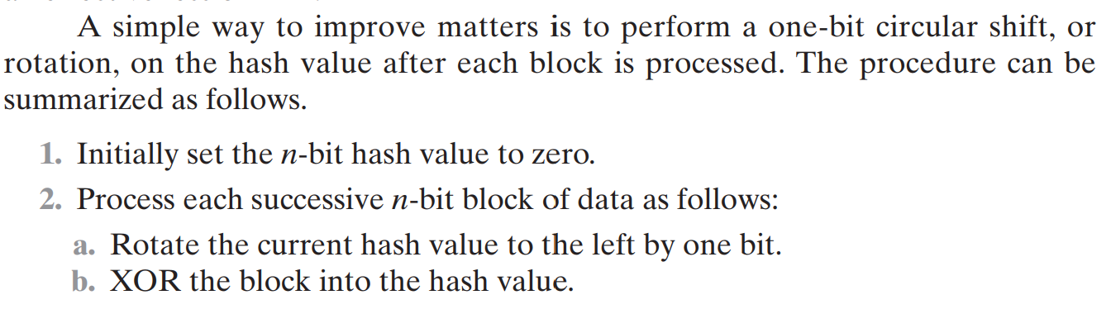
TWO SIMPLE HASH FUNCTIONS

Slide 18
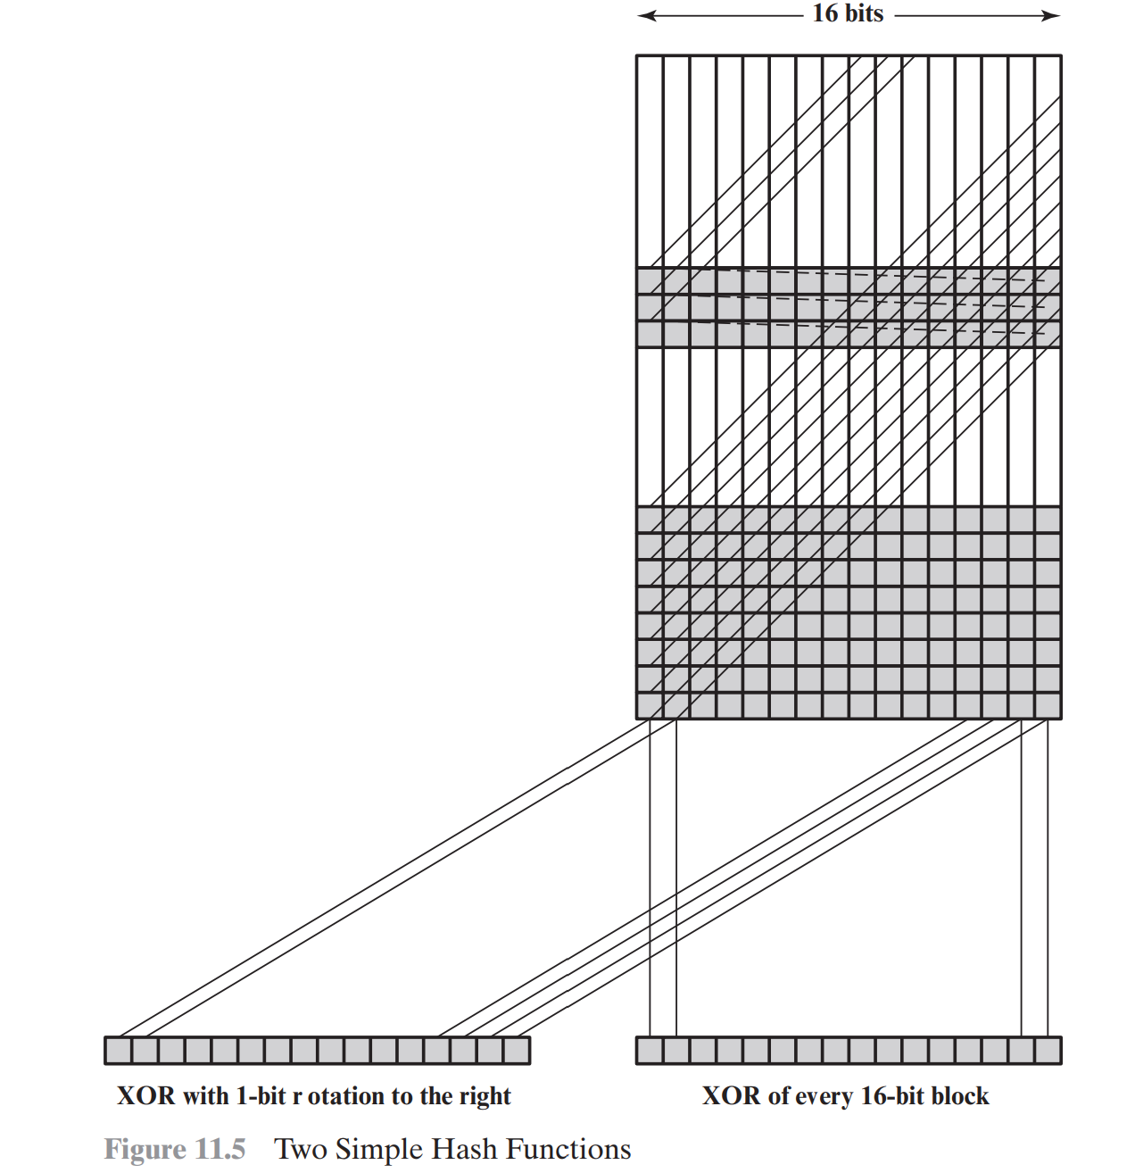

Slide 19
a simple XOR or rotated XOR (RXOR) is insufficient
A technique originally proposed by the National Bureau of Standards used the simple XOR applied to 64-bit blocks of the message and then encryption of the entire message that used the cipher block chaining (CBC) mode.
The Scheme can be defined as follows: Given a message M consisting of a sequence of 64-bit blocks X1, X2, …, XN, define the hash code h = H(M) as the block-by-block XOR of all blocks and append the hash code as the final block:

Slide 20
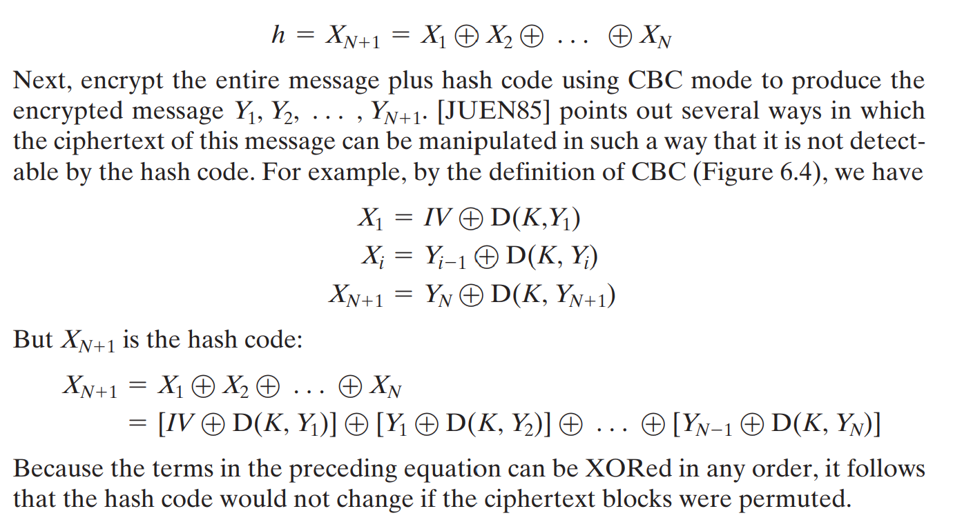

Slide 21
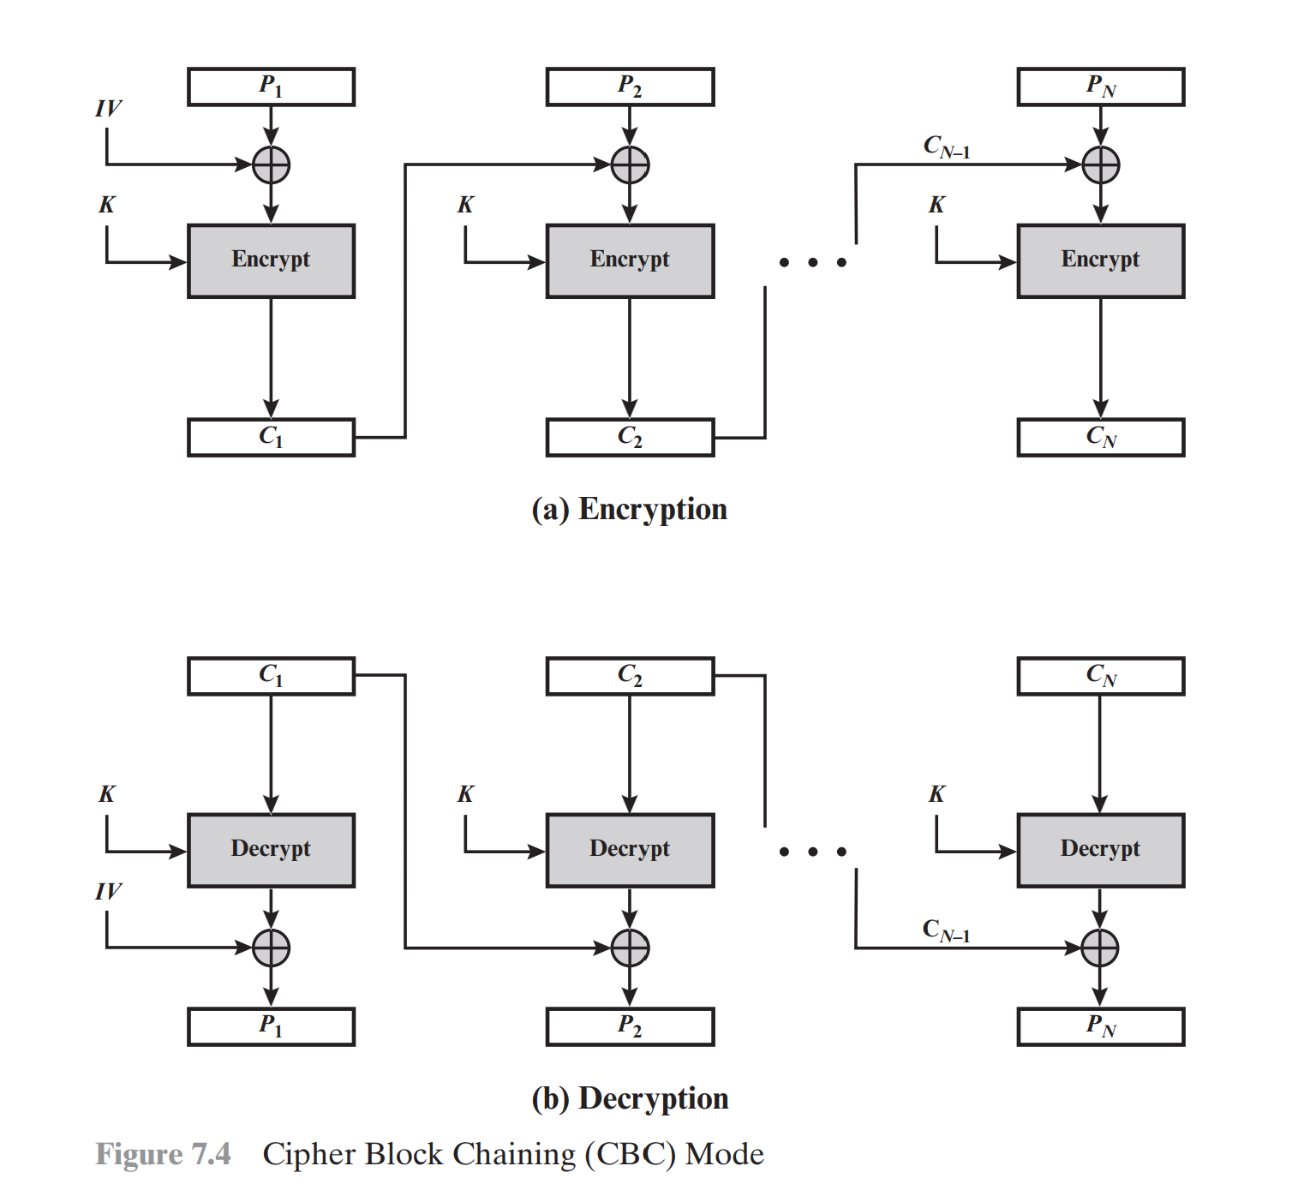
Cipher Block Chaining (CBC) Mode

Slide 22
CH 12 -General Security Requirements (resistance against the following attacks)
disclosure
traffic analysis
masquerade
content modification
sequence modification
timing modification
source repudiation
destination repudiation
Notes:
In the context of communications across a network, the attacks listed above can be identified.
The first two requirements belong in the realm of message confidentiality, and are handled using the encryption techniques already discussed.
The remaining requirements belong in the realm of message authentication. At its core this addresses the issue of ensuring that a message comes from the alleged source and has not been altered. It may also address sequencing and timeliness. The use of a digital signature can also address issues of repudiation by the source.

Slide 23
Attacks against communication networks
Disclosure: Release of message contents to any person or process not possessing the appropriate cryptographic key.
Traffic analysis: Discovery of the pattern of traffic between parties. In a connection-oriented application, the frequency and duration of connections could be determined. In either a connection-oriented or connectionless environment, the number and length of messages between parties could be determined.
Masquerade: Insertion of messages into the network from a fraudulent source. This includes the creation of messages by an opponent that is purported to come from an authorized entity. Also included are fraudulent acknowledgments of message receipt or nonreceipt by someone other than the message recipient.
Content modification: Changes to the contents of a message, including insertion, deletion, transposition, and modification.

Slide 24
Attacks against communication networks
Sequence modification: Any modification to a sequence of messages between parties, including insertion, deletion, and reordering.
Timing modification: Delay or replay of messages. In a connection-oriented application, an entire session or sequence of messages could be a replay of some previous valid session or individual messages in the sequence could be delayed or replayed. In a connectionless application, an individual message could be delayed or replayed.
Source repudiation: Denial of transmission of a message by source.
Destination repudiation: Denial of receipt of the message by destination

Slide 25
Message Authentication Functions
message authentication is concerned with:
protecting the integrity of a message
validating identity of originator
non-repudiation of origin (dispute resolution)
will consider the security requirements
Notes:
Up untill now, have been concerned with protecting message content (ie secrecy) by encrypting the message. Will now consider how to protect message integrity (ie protection from modification), as well as confirming the identity of the sender. Generically this is the problem of message authentication, and in eCommerce applications is arguably more important than secrecy. Message Authentication is concerned with: protecting the integrity of a message, validating identity of originator, & non-repudiation of origin (dispute resolution). There are three types of functions that may be used to produce an authenticator: message encryption, message authentication code (MAC), or a hash function.

Slide 26
MESSAGE AUTHENTICATION REQUIREMENTS
Measures to deal with the first two attacks are in the realm of message confidentiality and are dealt with in Part One.
Measures to deal with items (3) through (6) in the foregoing list are generally regarded as message authentication.
Mechanisms for dealing specifically with item (7) come under the heading of digital signatures.
Generally, a digital signature technique will also counter some or all of the attacks listed under items (3) through (6).
Dealing with the item (8) may require a combination of the use of digital signatures and a protocol designed to counter this attack.

Slide 27
MESSAGE AUTHENTICATION FUNCTIONS
Hash function: A function that maps a message of any length into a fixed-length hash value, which serves as the authenticator
Message encryption: The ciphertext of the entire message serves as its authenticator
Message Authentication Code (MAC): A function of the message and a secret key that produces a fixed-length value that serves as the authenticator

Slide 28
Message Encryption
SYMMETRIC ENCRYPTION
PUBLIC-KEY ENCRYPTION

Slide 29
Message Encryption
message encryption by itself also provides a measure of authentication
if symmetric encryption is used then:
receiver know sender must have created it
since only sender and receiver know key used
content can not be altered
message has suitable structure, redundancy or a checksum to detect any changes
Notes:
Message encryption by itself can provide a measure of authentication. Here, the ciphertext of the entire message serves as its authenticator, on the basis that only those who know the appropriate keys could have validly encrypted the message. This is provided you can recognize a valid message (ie if the message has suitable structure such as redundancy or a checksum to detect any changes).

Slide 30
Message Encryption
if public-key encryption is used:
encryption provides no confidence of sender
since anyone potentially knows public-key
however if
sender signs message using their private-key
then encrypts with recipients public key
have both secrecy and authentication
again need to recognize corrupted messages
but at cost of two public-key uses on message
Notes:
With public-key techniques, can get a digital signature which can only have been created by key owner. But at cost of two public-key operations at each end on message.

Slide 31
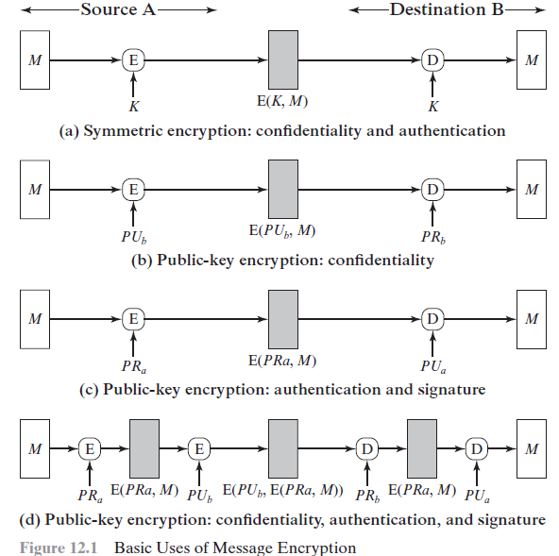

Slide 32
frame check sequence (FCS) or checksum
If the plaintext is, say, a binary object file or digitized X-rays, determination of properly formed and therefore authentic plaintext may be difficult.
Thus, an opponent could achieve a certain level of disruption simply by issuing messages with random content purporting to come from a legitimate user.
One solution to this problem is to append an error-detecting code, also known as a frame check sequence (FCS) or checksum, to each message before encryption

Slide 33
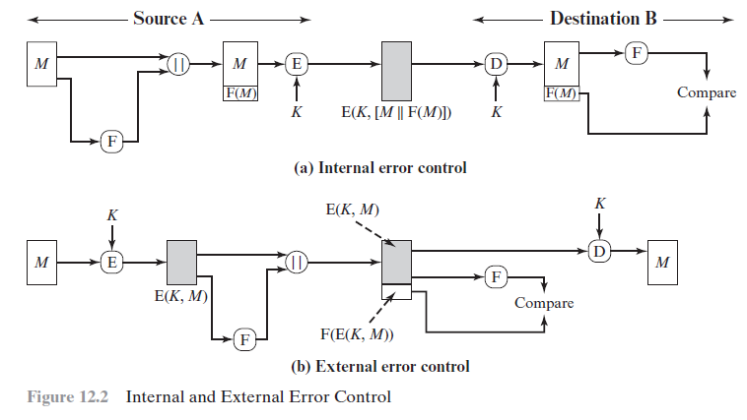
Types of FCS

Slide 34
Message Authentication Code (MAC)
generated by an algorithm that creates a small fixed-sized block
depending on both message and some key
like encryption though need not be reversible
appended to message as a signature
receiver performs same computation on message and checks it matches the MAC
provides assurance that message is unaltered and comes from sender
Notes:
An alternative authentication technique involves the use of a secret key to generate a small fixed-size block of data, known as a cryptographic checksum or MAC that is appended to the message. This technique assumes that two communicating parties, say A and B, share a common secret key K. A MAC function is similar to encryption, except that the MAC algorithm need not be reversible, as it must for decryption.

Slide 35

Message Authentication Code
M – input message
C – MAC function
K – shared secret key
MAC – message authentication code
Notes:
Stallings Figure 11.4a “Message Authentication” shows the use of a MAC just for authentication.

Slide 36
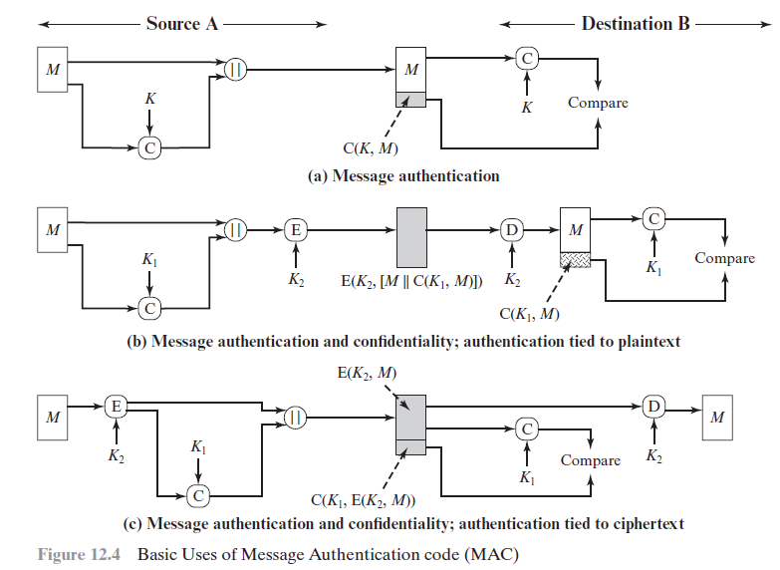

Slide 37
Message Authentication Codes
as shown the MAC provides authentication
can also use encryption for secrecy
generally use separate keys for each
can compute MAC either before or after encryption
is generally regarded as better done before
why use a MAC?
sometimes only authentication is needed
sometimes need authentication to persist longer than the encryption (eg. archival use)
note that a MAC is not a digital signature
Notes:
Can combine use of MAC with encryption in various ways to provide both authentication & secrecy.
Use MAC in circumstances where just authentication is needed (or needs to be kept), see text for examples.
A MAC is NOT a digital signature since both sender & receiver share key and could create it.

Slide 38
Message Authentication Codes
The receiver is assured that the message has not been altered. If an attacker alters the message but does not alter the MAC, then the receiver’s calculation of the MAC will differ from the received MAC. Because the attacker is assumed not to know the secret key, the attacker cannot alter the MAC to correspond to the alterations in the message.
The receiver is assured that the message is from the alleged sender. Because no one else knows the secret key, no one else could prepare a message with a proper MAC.

Slide 39
Message Authentication Codes
If the message includes a sequence number (such as is used with HDLC, X.25, and TCP), then the receiver can be assured of the proper sequence because an attacker cannot successfully alter the sequence number.

Slide 40
why use a MAC?
There are a number of applications in which the same message is broadcast to a number of destinations. Examples are notification to users that the network is now unavailable or an alarm signal in a military control center. It is cheaper and more reliable to have only one destination responsible for monitoring authenticity. Thus, the message must be broadcast in plaintext with an associated message authentication code. The responsible system has the secret key and performs authentication. If a violation occurs, the other destination systems are alerted by a general alarm.

Slide 41
why use a MAC?
Another possible scenario is an exchange in which one side has a heavy load and cannot afford the time to decrypt all incoming messages. Authentication is carried out on a selective basis, messages being chosen at random for checking.
Authentication of a computer program in plaintext is an attractive service. The computer program can be executed without having to decrypt it every time, which would be wasteful of processor resources. However, if a message authentication code were attached to the program, it could be checked whenever assurance was required of the integrity of the program.

Slide 42
why use a MAC?
For some applications, it may not be of concern to keep messages secret, but it is important to authenticate messages. An example is the Simple Network Management Protocol Version 3 (SNMPv3), which separates the functions of confidentiality and authentication. For this application, it is usually important for a managed system to authenticate incoming SNMP messages, particularly if the message contains a command to change parameters at the managed system. On the other hand, it may not be necessary to conceal the SNMP traffic.

Slide 43
why use a MAC?
Separation of authentication and confidentiality functions affords architectural flexibility. For example, it may be desired to perform authentication at the application level but to provide confidentiality at a lower level, such as the transport layer.
A user may wish to prolong the period of protection beyond the time of reception and yet allow processing of message contents. With message encryption, the protection is lost when the message is decrypted, so the message is protected against fraudulent modifications only in transit but not within the target system.
note that the MAC does not provide a digital signature, because both sender and receiver share the same key.

